Slide 1

REGISTRAR INTERFACE
https://registry.amnic.net/REGISTRY
Աննա Կարախանյան

Slide 2
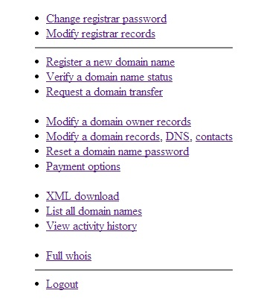
Registrar Interface to REGISTRY DATABASE

Slide 3
REGISTRAR Interface to REGISTRY DATABASE
Change registrar password
Modify registrar records
Register a new domain name
Verify a domain name status
Request a domain transfer

Slide 4
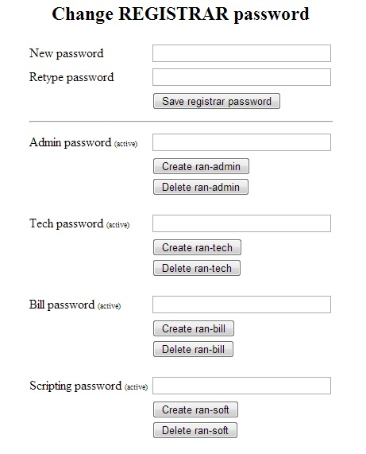
Change REGISTRAR password

Slide 5
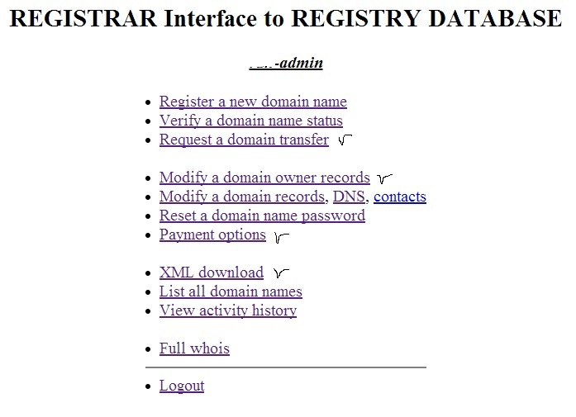
Registrar Admin interface

Slide 6
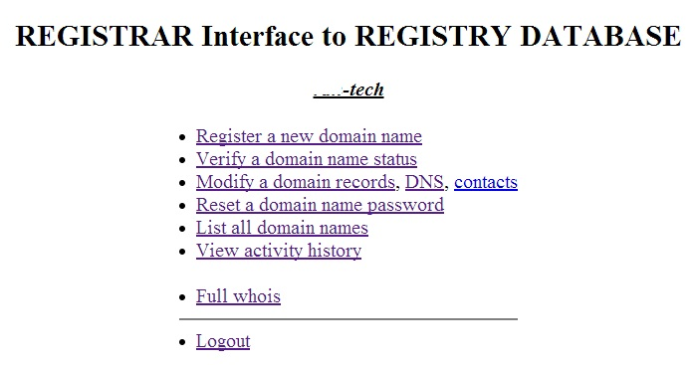
Registrar tech interface

Slide 7
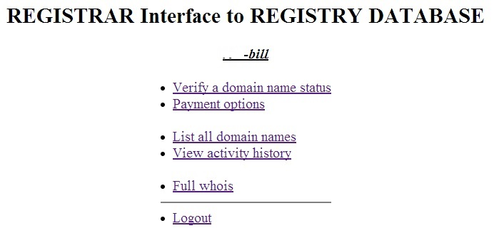
Registrar Billing interface

Slide 8
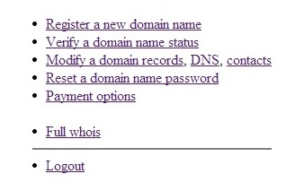
registrar-soft

Slide 9
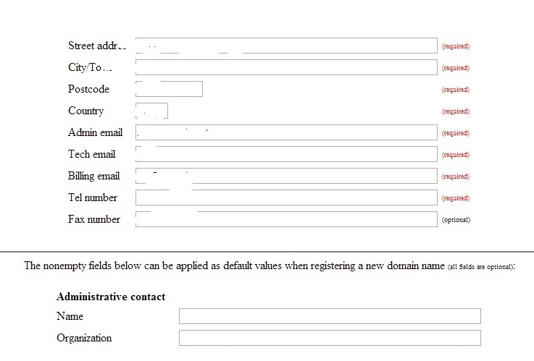
Modify REGISTRAR records

Slide 10
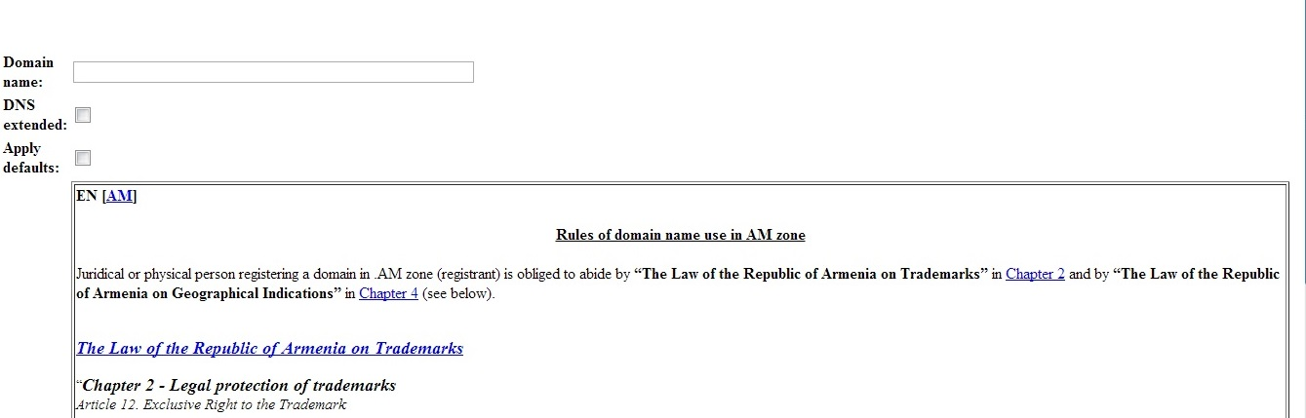
.AM domain registration form

Slide 11
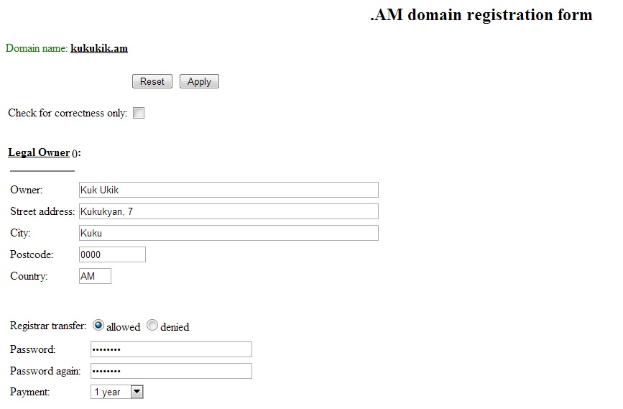
.AM domain registration form

Slide 12
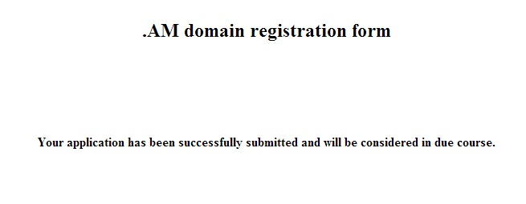

Slide 13
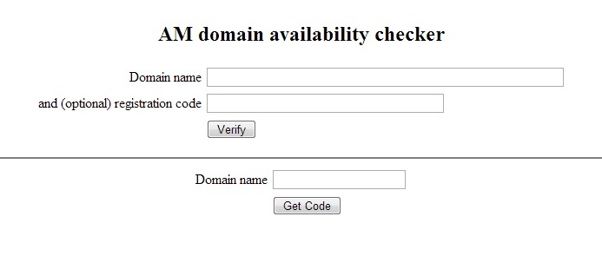
VERIFY DOMAIN NAME STATUS
available or not available

Slide 14
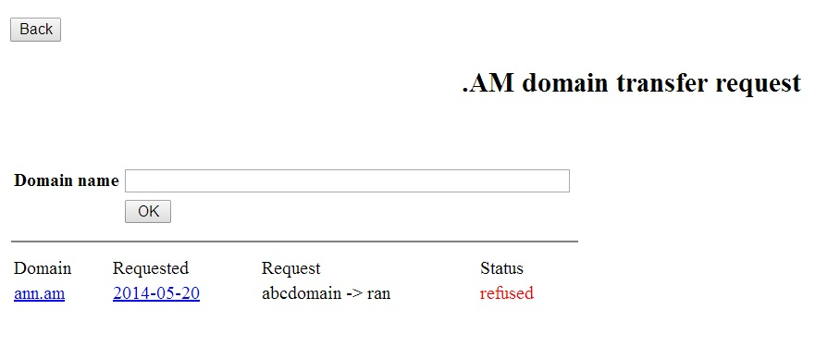

Request A domain transfer
Ռեգիստրարի փոփոխությունը հնարավոր է միայն ռեգիստրացիյաից երկու ամիս անց:

Slide 15
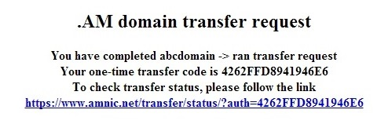
.AM domain transfer request

Slide 16
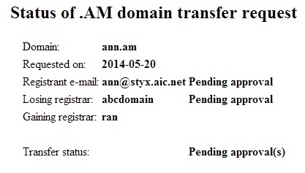
Status of .AM transfer request

Slide 17
Message to admin contact
Dear Sir/Madam, ran requested transfer of your domain ann.am from abcdomain to their management. You have one week to either approve: https://www.amnic.net/transfer/approve/?auth=40645EF7ECCB9328 or refuse: https://www.amnic.net/transfer/refuse/?auth=40645EF7ECCB9328 the transfer You can also check the status of the transfer: https://www.amnic.net/transfer/status/?auth=40645EF7ECCB9328 AM Network Information Centre

Slide 18
REGISTRAR Interface to REGISTRY DATABASE
Modify a domain owner records
Modify a domain records, DNS, contacts
Reset a domain name password
Payment options

Slide 19
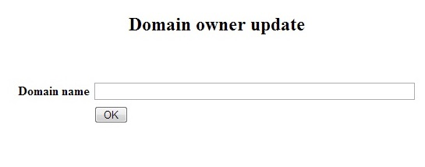
Modify a domain owner records

Slide 20
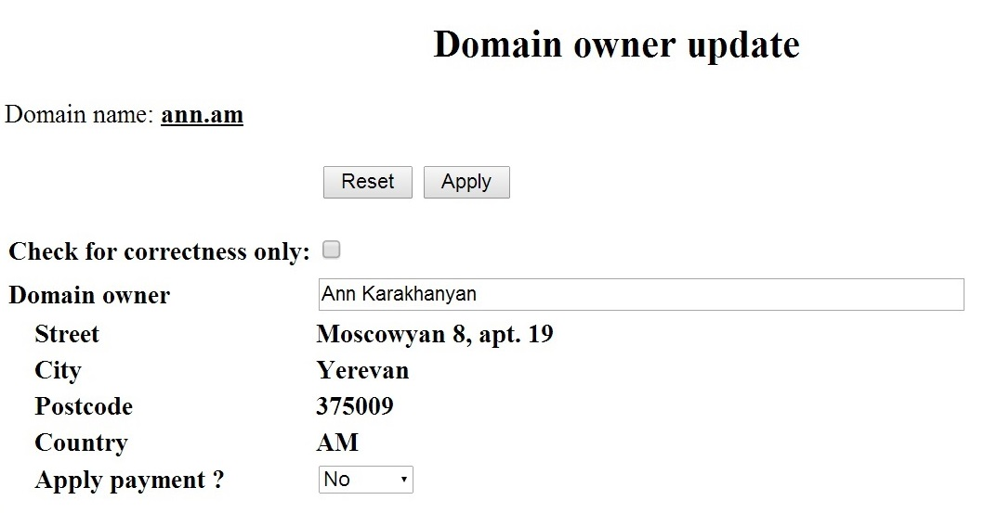
Domain owner update

Slide 21
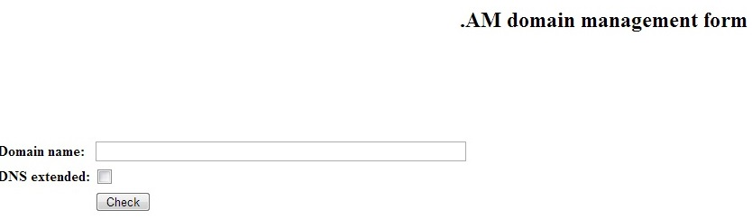
Modify a domain records, DNS, contacts

Slide 22
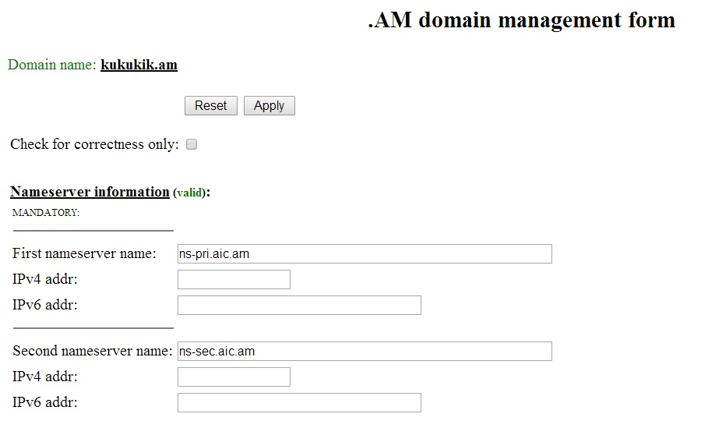
ONLY DNS change

Slide 23
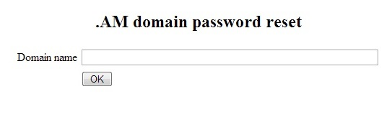

Reset a domain name password

Slide 24
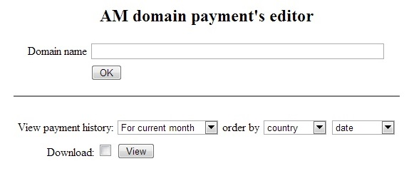
Payment options

Slide 25
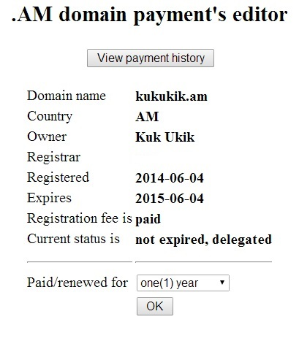

Slide 26
REGISTRAR Interface to REGISTRY DATABASE
XML download
List all domain names
View activity history
Full whois

Slide 27
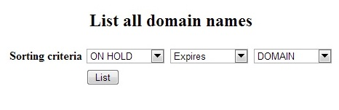
List all domain names

Slide 28
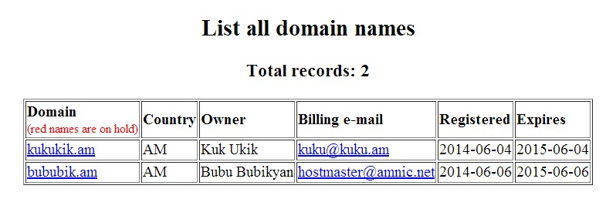

Slide 29
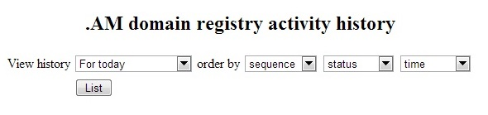
.AM domain registry activity history

Slide 30
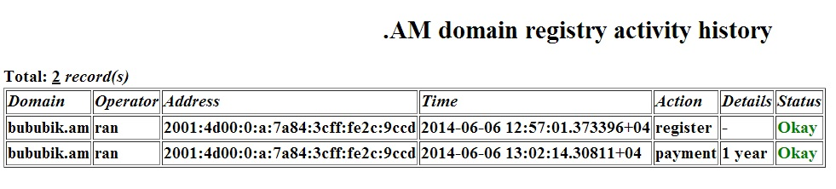

Slide 31
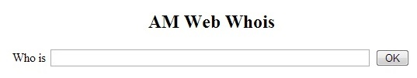
AM Web Whois

Slide 32
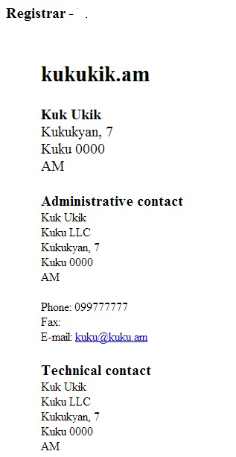

Slide 33
Շնորհակալություն ուշադրության համար
Աննա Կարախանյան

