Slide 1
Network Neutrality, operators and regulators
Grigori Saghyan
VP
ISOC.AM

Slide 2
Introduction
Why is the Network Neutrality a subject of discussion?
Economical aspects of Network Neutrality

Slide 3
Topics to be discussed
Changes in the telecomm sphere during last 20 years
How many voice traffic is there in the networks ?
Mutual settlements between networks
Who is against Network Neutrality and who supports it?
Conclusion

Slide 4
Changes in the telecom sphere during last 20 years
Movement of operators to Internet technologies
Implementation of Open Standards
Asynchronous technologies
Switching on fiber optic lines – capacity increases 10exp6 times
Moore’s law – increasing of IC capacity 2 times during each 18 months
Slight regulation in 2.4 5.2, 5.8 GHz band
Demonopolization of telecom in Europe
New system of mutual settlements in telecom
Price for Mbyte goes down, up to zero.

Slide 5
How many voice traffic is there in the networks ?
There was 46 Exabyte (10ехр18 bytes) monthly in the Internet in 2012
International TDM voice traffic was 501 billion minutes or 8*(10ехр15) bytes with G.729 Codec
Traditional telecom companies turnover was 1.6 trillion dollars from voice
Data turnover was 0.4 trillion dollars
Voice traffic was less than 100 times in global traffic, but costs 3 000 times more.

Slide 6
Mutual settlements in telephony
Network 1 Network 2

Slide 7
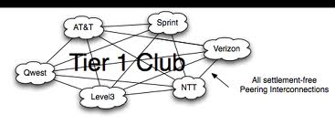
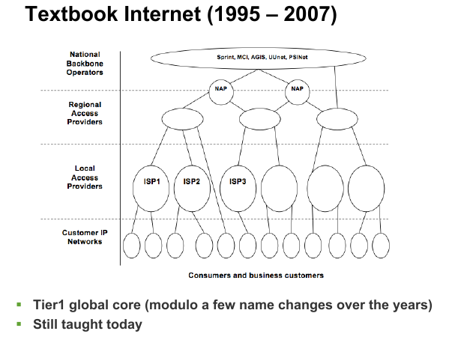

Slide 8
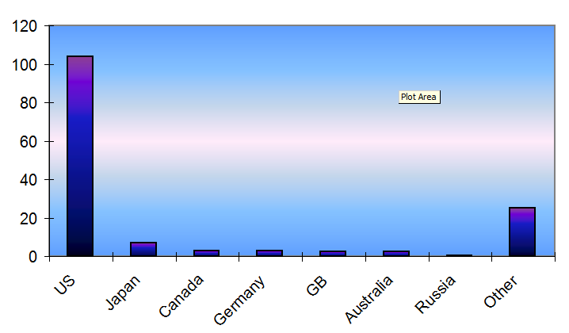
Imbalance reasons

Slide 9
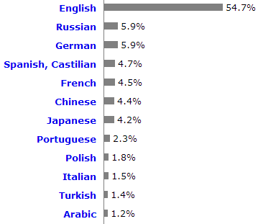
Imbalance reasons 2

Slide 10
Who is against Network Neutrality
Traditional TDM operators – 1.6 trilion dollars will dissolved
Regulators in development countries – do not know from where it will be possible to find money for network development
Countries, who do not want to accept dominant role of US on network and application level
ITU – there is no any model for mutual statements, only model for telephony

Slide 11
Who supports Network Neutrality
New operators – Skype, Viber, Gogle, Facebook, others
Countries, where competition is supported
Countries, who do not have any ideological resistance against content on English

Slide 12
Conclusion
Current situation is transitional, there is no any doubts, that traditional operators will move to the Internet based technologies and will have huge financial loses
High tariff for TDM minute is artificial
Networks will be developed based on cross-financing, and this cross financing will come not from telecom services, but from other sources
Telecommunications will be free of charge, it will be something like free of charge supplement for other services.

Slide 13
Questions?
Grigori Saghyan
gregorsag@gmail.com

