Slide 1

Armenian edition of Jovan Kurbalija’s book
“Internet Governance”
I.Mkrtumyan, ISOC AM
H.Baghyan, MediaEducation Center

Slide 2
Organizations that make up the Internet include:
Technologists, engineers, architects, creatives, organizations such as the Internet Engineering Task Force (IETF) and the World Wide Web Consortium (W3C) who help coordinate and implement open standards.
Global and local Organizations that manage resources for global addressing capabilities such as the Internet Corporation for Assigned Names and Numbers (ICANN), including its operation of the Internet Assigned Numbers Authority (IANA) function, Regional Internet Registries (RIR), and Domain Name Registries and Registrars.
Operators, engineers, and vendors that provide network infrastructure services such as Domain Name Service (DNS) providers, network operators, and Internet Exchange Points (IXPs)

Slide 3
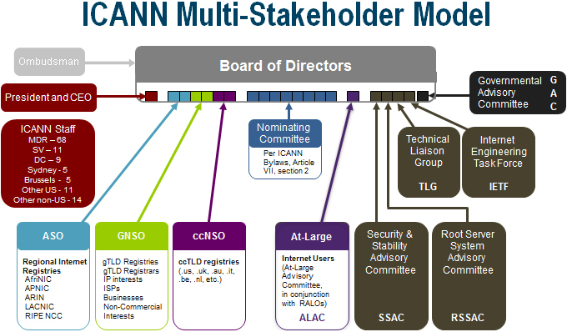
ICANN Organizational Chart

Slide 4
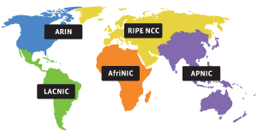
What is an RIR?

Slide 5
The Internet Assigned Numbers Authority (IANA) allocates addresses to each RIR. The RIR is responsible for the next level of allocation to large regional entities including Internet Service Providers (ISPs), educational institutions, government bodies, and large private enterprises.
American Registry for Internet Numbers (ARIN)
Reseaux IP Europeens Network Coordination Centre (RIPE NCC)
Asia-Pacific Network Information Centre (APNIC)
Latin American and Caribbean Internet Address Registry (LACNIC)
African Network Information Centre (AfriNIC)

Slide 6
What is a Local Internet Registry (LIR)?
Local Internet Registries (LIR) are responsible for the distribution of address space and registration of the address space on a local level.

Slide 7
Resident Local Internet Registries offering service in Armenia
"ArmenTel" CJSC
K-Telecom CJSC
Armenia Network Information Center (AMNIC)
"Orange Armenia" CJSC
Pimox LLC
Ucom LLC
WEB Ltd
Armenian Datacom Company
Apaga Technologies CJSC
Crossnet LLC
FiberNet Communication LLC
GNC-Alfa CJSC
Icon Communications CJSC
Interactive TV LLC
Netsys JV LLC
Hi-Tech Gateway LLC.
IIAP

Slide 8
A root name server is a name server for the Domain Name System's root zone. It directly answers requests for records in the root zone and answers other requests returning a list of the designated authoritative name servers for the appropriate top-level domain (TLD). The root name servers are a critical part of the Internet because they are the first step in translating (resolving) human readable host names into IP addresses that are used in communication between Internet hosts.
The choice of 13 nameservers was made because of limitations in the original DNS specification, which specifies a maximum packet size of 512 bytes when using the User Datagram Protocol (UDP).

Slide 9
ROOT-SERVERS name org city type
a NSI Herndon, VA, US com
b USC-ISI Marina del Rey, CA, US edu
c PSInet Herndon, VA, US com
d U of Maryland College Park, MD, US edu
e NASA Mt View, CA, US usg
f Internet Software C. Palo Alto, CA, US com
g DISA Vienna, VA, US usg
h ARL Aberdeen, MD, US usg
I NORDUnet Stockholm, SE int
j NSI (TBD) Herndon, VA, US (com)
k RIPE London, UK int
l ICANN Marina del Rey, CA, US org
m WIDE Tokyo, JP edu

Slide 10
DNS explained
http://www.youtube.com/watch?v=42pxnLZJXzo
Root servers http://www.youtube.com/watch?v=PUaxX_7hQnU

Slide 11
Armenian Datacom Company (ADC) and Netnod have announced today they installed an instance of i.root-servers.net in one of ADC’s data centres. This is the first DNS root server in Armenia, which will contribute to the reliability and redundancy in DNS services to Internet users in Armenia and surrounding regions.

Slide 12
ccTLD (Country Code TLD)
Country NIC
Armenia – ISOC AM (AMNIC)
Country Registry
Armenia – AMNIC
Registry - Registrars

Slide 13
ISOC AM – ICANN relations
ISOC AM is recognized by ICANN as Armenia Internet Manager and Registry
ISOC AM is a member of ccNSO
ISOC AM is a member of ALAC
Armenia is represented in GAC by MTC

Slide 14
Regional councils of ccTLD registries
Council of European National Top-Level Domain Registries (CENTR)
Council of the Asia Pacific country code Top Level Domains (APTLD)
Council of African country code Top Levell Domains (AfTLD)
Council of Latin America & Caribbean country code Top Levell Domains (LACTLD)

