Slide 1

AM TLD governance
(for Registrars workshop)
I.Mkrtumyan
ISOC AM
ISOC Annual Meeting, Yerevan, Nov. 7, 2012
1

Slide 2
Organizing Internet Community
To get the rights for TLD management the organization must be managed by of the country Internet Community.
ISOC AM was founded in 1994 to represent the Armenia Internet Community.
The Society is governed by the Council re-elected each year. The main goal of the Society is to assist to the development of Internet in Armenia.

Slide 3
ISOC AM membership
ISOC AM has about 120 members, representing National Academy of Science, international foundations, major ISPs, university and library networks, academic, research and school networks, regional Internet users groups, individual Internet users as well as the government representative.
3

Slide 4
ISOC AM membership
To become a member of ISOC AM an applicant fills an application and sends it to isoc@isoc.am.
After receiving an application we sign the applicant as a member of Global ISOC and include him in the ISOC AM Chapter roster. The applicant got a Global ISOC membership number.
Then we include him in ISOC AM mailing list.
The membership fee is 1,000 AMD per year.

Slide 5
ISOC AM membership advantages
Being informed about the ISOC AM events
Participation in conferences
Financial support of participation in conferences (last event INET-Istanbul)
Possibility to get fellowship from ICANN, ISOC, CEENet

Slide 6
  Internet Society Armenia (ISOC AM) is a manager of AM domain.
  Internet Technologies Center (ITC-AMNIC) is a daughter company of ISOC AM and the Registry of AM TLD
6

Slide 7
AM TLD governance infrastructure
Registrars
  AM TLD Manager
Registry
ISOC AM
ITC (AMNIC)
Internet users, representing organizations and individuals
7

Slide 8
AM TLD governance infrastructure
  Global ISOC
  www.internetsociety.org
  ICANN
  www.icann.org
  CENTR
  www.centr.org
  ISOC Chapter
(ISOC AM)
www.isoc.am
ITC (AMNIC)
Registry
8

Slide 9
Juridical base of ISOC AM activity
Contract with ICANN
Agreement with ISOC
Memorandum of cooperation with MTC RA

Slide 10
Registrars
AATVC
ABCDomain
ARANEA
Armenian Datacom Company
Arminco-NK
Arpinet
Dolphin
GlobalAR
iCON Communications
K-Telecom (VivaCell-MTS)
Mastercomp
NETSYS JV
ShTE
Ucom
WEB

Slide 11
Aims of Internet Society: Supporing the main principles of the Internet governance
Open and transparent Internet
Human rights
Universal access and net neutrality
Multistakeholderism
Cyber-security,
Stability,
Open standards,
Cultural and language diversity,
Preventing of trans-border harm by countries,

Slide 12
Aims of Internet Society: Supporing the main principles of the Internet governance
Բաց եւ թափանցիկ ինտերնետ
Մարդու իրավունքները
Universal հասանելիության եւ չեզոքության
Բազմաչահարու կառավարման մոդել
Կիբեր-անվտանգության
Կայունություն
Բաց ստանդարտները,
Մշակութային եւ լեզվական բազմազանությունը,
Երկրների միջև սահմանային վնասի կանխարգելում

Slide 13
Problems of Internet Governance
Cybercrime (Կիբերռհանցագորղւոթյուն)
Internet management: from WCIT 2012 to
WSIS 2015: (Ինտերնետի կառավարում)
Predictions of the Future
(Ինտերնետի ապագան)
Juridic aspects of Internet regulations
(Ինտերնետի կանոնակարգման
իրավանաբանական հարցերը)
e-government (էլ.կառավարություն)
Children Internet (Երեխաների Ինտերնետ)
Economics of domain industry (Դոմենային
քաղաքականության զարգացում)

Slide 14
Problems of Internet Governance
Cybersecurity and open Internet (Կիբեր անվտանգություն և բաց Ինտերնետ)
Personal privacy(անձնական կյանքի գաղտնիությունը Ինտերնետում)
Internet traffic filtration (տրաֆիկի ֆիլտացիյա)
Blocking access to Internet resources (Ինտերնետ Ռեսուրսների հասանելիւոթյան արգելակումը)
Consequences of blocking groups of people, countries, etc (արգելակման հետևանքները)

Slide 15
ISOC AM activity for the sake of Internet development in Armenia
Sponsoring of the first International Conference on Telemedicine
Sponsoring of the creation of Armenian Internet Traffic Exchange (ARMIX)
Sponsoring of the upgrade of the scientific research network to the IP6 readiness
Sponsoring of the project of digitization of publications in the National Library
Sponsoring of the creation of the Internet availability Center for Blinds

Slide 16
ISOC AM Activity for the sake of Internet development in Armenia
Sponsoring of the national survey on the Internet penetration in Armenia
Sponsoring of the annual Internet conference (ArmNet), where the winners of the best web sites in different nominations are announced
Sponsoring with the Global ISOC of the joint INET-Armenia conference and trainings on Internet Exchange (IX)

Slide 17
ISOC AM Activity for the sake of Internet development in Armenia
Application to ICANN for Armenian IDN domain .հայ
Participation in conferences
Financial support of business trips (last event: INET-Istanbul)

Slide 18
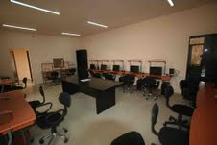
Internet Availability Center for Blinds

Slide 19
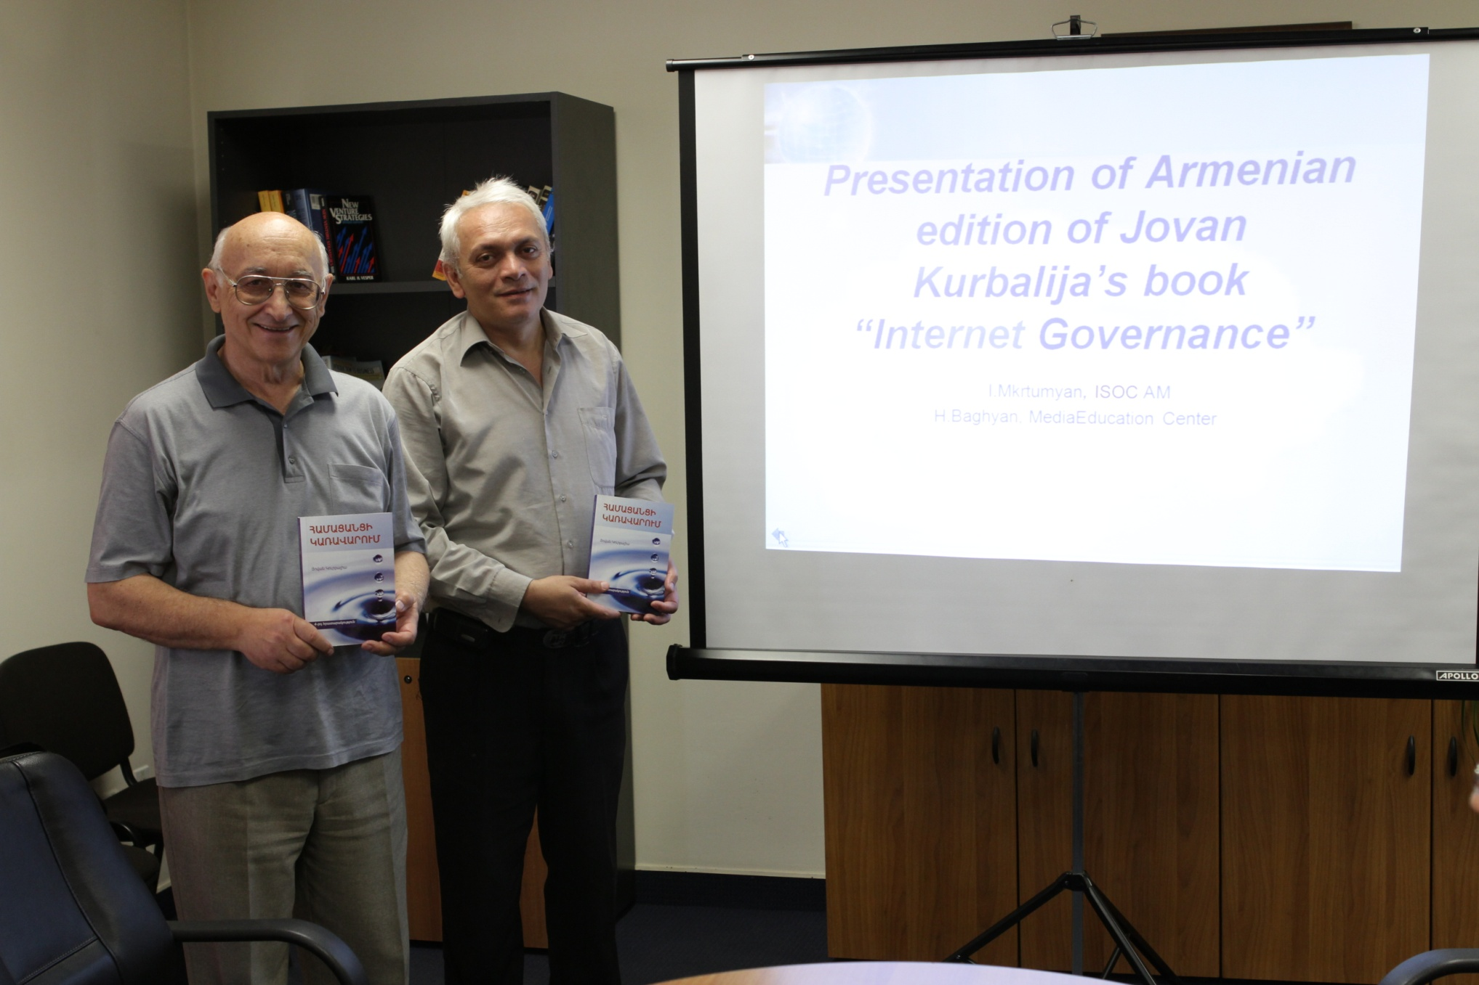
Translation of the “Internet Governance” book into Armenian”

Slide 20
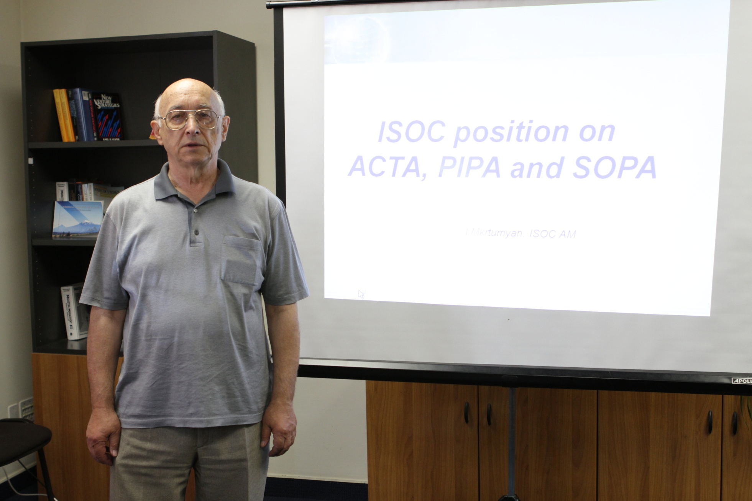
Workshops on the most actual Internet problems

Slide 21
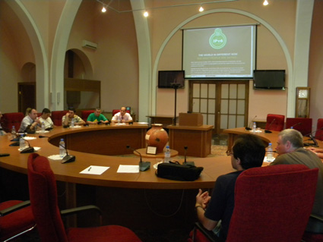
IPv6 days in Armenia

Slide 22
Internet penetration in Armenia

Slide 23
Internet penetration in Armenia

Slide 24
Internet penetration in Armenia
Name | Number of respondents | Using Internet |  | % of Internet penetration
 |  | Yes | No
Yerevan | 1055 | 638 | 417 | 60,5%
Regions | 419 | 201 | 218 | 48,0%
RA | 1474 | 839 | 635 | 56,9%

Slide 25
Main reasons of not using the Internet

Slide 26
  ISOC AM is a member of ccNSO и ALC of ICANN, member of CENTR and CEENet
26

Slide 27
Main tasks of the Internet Technologies Center (AMNIC)
Supporting of the national DNS servers on the modern technological level, providing reliable DNS service
- Hardware upgrade
- DNSSEC
- IPv6
Providing quality service to Registrars and Registrants
Development and update of domain registration rules in .am zone and bringing them in the correspondence with the national laws.
Development of rules of dispute resolution and coordination them with WIPO
27

Slide 28
Reliability of the DNS service of Armenia
  Two high-speed independent Internet connection
  Two independent power source supplies
  Up-to date hardware
  Instances of DNS servers in ASNET-AM
  DNSSEC
  Community DNS server
28

Slide 29
DNSSEC
DNSSEC – introduced in July 2011
29

Slide 30
Community DNS server
CDNS supports about 68% of the whole Internet domain names
30

Slide 31
Country DNS IPv6 readiness
DNS services are IPv6 ready since 2006
31

Slide 32
Free of charge domains
Presidential, governmental, ministerial and municipal domains are registered free of charge and without time limit
Domains of NGOs and benevolent organizations can be included into the free of charge list by the decision of ISOC AM Board
32

Slide 33
Stop list includes
600 names of brands
Unethical names
33

Slide 34
Number of domains registered in .AM zone
34

Slide 35
Dispute resolution
AMNIC adopted UDRP as a dispute resolution protocol with WIPO’s arbitration
35

Slide 36
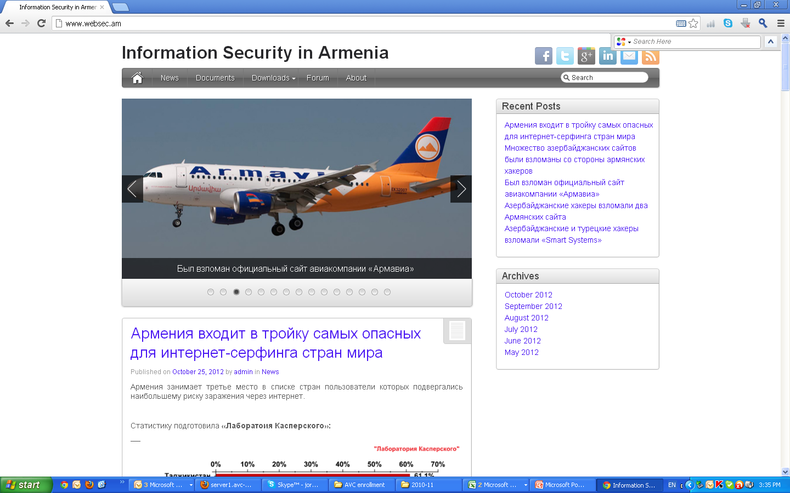
Monitoring of the hacking of .AM web space
Websec.am
36

Slide 37
Thank you!
37

