Slide 1

South Eastern European
Dialogue on Internet Governance
22 April 2016
Belgrade, Serbia
Lianna Galstyan
Executive Committee Member
ISOC Armenia Board Member

Slide 2
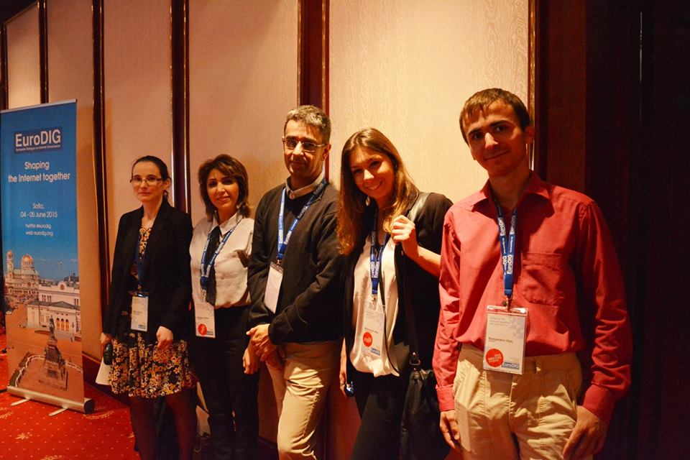
Executive Committee
Coordination of SEEDIG activities is done by a multistakeholder and regionally diverse executive committee.
  Sorina Teleanu, DiploFoundation, Romania
  Aida Mahmutović, Centre for Internet Governance, Bosnia and Herzegovina
  Lianna Galstyan, Internet Society Armenia
  Iliya Bazlyankov, UNICART, Bulgaria
  Dušan Stojičević, Serbian National Internet Domain Registry (RNIDS), Serbia

Slide 3
Host and local institutional partners 2016
Serbian National Internet Domain Registry (RNIDS)
Ministry of State Administration and Local Self-Government – Directorate for eGovernment
Ministry of Trade, Tourism and Telecommunications

Slide 4
Sponsors 2016
Internet Society (ISOC)
Internet Corporation for Assigned Names and Numbers (ICANN)
RIPE Network Coordination Centre (RIPE NCC)
Afilias
Internet Governance Forum Support Association (IGFSA)
Serbian Open eXchange (SOX)
Serbian Broadband (SBB)
ISTanCo

Slide 5
Other supporting organizations 2016
Council of Europe
DiploFoundation
European Commision
European Dialogue on Internet Governance (EuroDIG)
Internet Governance Forum (IGF)
Center for Internet Governance
Internet Society Armenia
One World Platform

Slide 6
Attendance Statistics
The SEEDIG 2016 meeting was attended by 116 on site participants, coming from a total of 22 countries: 16 countries from South Eastern Europe and the neighbouring area (representing 91% of all participants), and six (6) countries from beyond the region (9% of all participants). Around 20 additional participants joined the meeting online, via the remote participation platform.
The countries that were represented at SEEDIG 2016 and could be considered as part of South Eastern Europe and the neighbouring area are: Albania, Armenia, Azerbaijan, Bosnia and Herzegovina, Bulgaria, Croatia, Georgia, Montenegro, Republic of Moldova, Romania, Russian Federation, Serbia, Slovenia, The former Yugoslav Republic of Macedonia, Turkey, and Ukraine.

Slide 7
Attendance Statistics
All stakeholder groups were represented at the meeting.
In terms of gender representation, 66% of all participants were male, and 31% female. Ten percent (10%) of all participants were youth representatives.

Slide 8
Session 1: Who governs the Internet in SEE?
Key participants:
  Andrea Beccalli, Internet Corporation for Assigned Names and Numbers (ICANN)
  Chris Buckridge, RIPE Network Coordination Centre (RIPE NCC)
  Frédéric Donck, European Regional Bureau, Internet Society (ISOC)
  Markus Kummer, Internet Governance Forum Support Association (IGFSA)
Moderator: Sorina Teleanu, DiploFoundation, Romania
Remote moderator: Ani Dallakyan, Internet Society Armenia
Rapporteur: Ana Kakalashvili, Deutsche Gesellschaft für Internationale Zusammenarbeit (GIZ) GmbH, Germany/Georgia

Slide 9
Session 1: Who governs the Internet in SEE?
Messages:
Internet governance (IG) is evolving with time. This evolution of IG makes the main actors be more open and inclusive.
IG is mostly and mainly about dialogue and collaboration between different actors. And ‘consensus’ is the key word in IG.
There is no single main actor in IG: governments are important, but so are users, the technical community, and the private sector. Civil society is bringing up a lot of important topics, but the governance of the Internet is further implemented together with other stakeholders.

Slide 10
Session 1: Who governs the Internet in SEE?
Messages:
Multistakeholderism is not a single model, but a set of (good) practices and behaviours that helps to improve the governance process and make more voices being heard. Participating on equal footing and inclusiveness are key words for multistakeholder Internet governance mechanisms.
Representativeness of stakeholder groups and ‘legitimacy’ are a matter of continuous discussion in IG. But, as long as the governance process is open and inclusive, we can call it multistakeholder.
(Better) global IG discussions should be shaped in a bottom-up way: from national level to (sub-)regional, and all the way to the global level.

Slide 11
Session 2: Bridging digital divide(s) with a #SEEchange in digital literacy
Key participants:
  Valentin Negoiță, Association of Producers and Distributors of ICT Equipment (APDETIC), Romania
  Megan Richards, Directorate General for Communications Networks, Content and Technology, European Commission, Belgium
  Vojislav Rodić, Serbian National Internet Domain Registry (RNIDS), Serbia
  Jan Žorž, Internet Society, Slovenia
Moderator: Dušan Stojičević, Serbia
Remote moderator & Rapporteur: Michael Oghia, Turkey/USA

Slide 12
Session 2: Bridging digital divide(s) with a #SEEchange in digital literacy
Messages:
There are many layers of Internet development in the South Eastern European region, from access and infrastructure (broadband included) to cost and affordability, literacy, content, and services. Deployment of infrastructure is insufficient in itself, and needs to be complemented by measures focused on education and development of local content, among others.
Internet access solely via mobile technologies should be seen only as a temporary access solution. Mobile technology does not provide complete access to the breadth of the Internet, and, as such, must be reinforced by fiber networks and better use of spectrum, especially in rural areas.

Slide 13
Session 2: Bridging digital divide(s) with a #SEEchange in digital literacy
Messages:
More efforts are needed in the region (both from the governments and the private sector) to improve the adoption of IPv6 and other Internet technologies that can contribute to bridging the digital divide.
Digital literacy and awareness about content like e-services or e-government, specifically in local languages and scripts, are critical to bridging the digital divide.
Internationalised Domain Names (IDNs) can contribute to bringing more people online. Supporting and encouraging the development and use of IDNs in the region is therefore extremely important.

Slide 14
Session 3: Discussing cyber(SEE)curity: global issues in regional context
Key participants:
  Axel Pawlik, Managing Director of the RIPE Network Coordination Centre (RIPE NCC)
  Desiree Miloshevic, Afilias
  Milan Sekuloski, Geneva Centre for the Democratic Control of Armed Forces (DCAF)
Moderators: Vladimir Radunović, DiploFoundation, Serbia
  Tatiana Tropina, Max Planck Institute for Foreign and International Criminal Law, Germany/Russian Federation
Remote moderator: Radoslav Rizov, Microsoft, Bulgaria
Rapporteur: Fotjon Kosta, Ministry of Energy and Industry, Albania

Slide 15
Session 3: Discussing cyber(SEE)curity: global issues in regional context
Messages:
There are differences in understanding what cybersecurity is among different stakeholders, be they public or private. This lack of harmonised approaches to the cybersecurity definition is combined with the lack of clarity concerning the role of different stakeholders, such as state, private sector, and civil society. Thus, a dialogue between different stakeholders has to be based on clear understanding of the definition and possible roles.
Accountability of all players, especially governments and security services, is a precondition of any working multistakeholder solution.

Slide 16
Session 3: Discussing cyber(SEE)curity: global issues in regional context
Messages:
The role of various stakeholders in protecting cybersecurity will continue to be shaped by the major shift from the concept of security as the duty of the state, to cybersecurity and protection of individuals as a shared responsibility. The distribution of duties and responsibilities among different stakeholders in the South Eastern European region is not established yet, and has to be figured out taking into account rule of law, human rights, and the balance between public and private interests. Governments and other stakeholders have to work together to find the best mechanisms for safeguarding cybersecurity and for a more balanced cyber environment.

Slide 17
Session 3: Discussing cyber(SEE)curity: global issues in regional context
Messages:
Since many of the cybersecurity strategies in the region do not include human rights issues, more attention and awareness is needed to develop the approaches that will implement human rights ‘by design’.
The rule of law is very important, especially when it comes to protecting humans rights and conducting criminal investigations in the digital environment. However, the law on paper is not enough – legal frameworks should be operational and functional.

Slide 18
Session 3: Discussing cyber(SEE)curity: global issues in regional context
Messages:
Governments are expected to play a vital role in protecting critical infrastructure, combating cybercrime, contributing to education (including through public-private partnerships), and protecting human rights. However, users should take their part of responsibility in protecting the security of their data and/or devices (for example through using end-to-end encryption), and not only rely on governments and private companies.

Slide 19
Session 4: Come and solve the human rights puzzle with us
Key participants:
  Patrick Penninckx, Council of Europe
  Nevena Ružić, Office of the Commissioner for Information of Public Importance and Personal Data Protection, Serbia
Moderators: Bogdan Manolea, Association for Technology and Internet, Romania
  Valentina Pellizzer, One World Platform Foundation, Bosnia and Herzegovina
Remote moderator: Auke Pals, Network of European Digital Youth, Netherlands
Rapporteur: Su Sonia Herring, youth delegate, Turkey

Slide 20
Session 4: Come and solve the human rights puzzle with us
Messages:
Privacy is one of the most important human rights online. Privacy and anonymity are needed to ensure that other human rights, such as freedom of expression and assembly, are freely exercised and protected.
Freedom of expression in every sense should be protected online.
Access to information will help ensure equality online.
An important question that needs further consideration is who should be more responsible when it comes to ensuring the protection of human rights online. Governments or the private sector?
Remedies to issues regarding human rights online need to be discussed by all stakeholders in length and depth.

Slide 21
Speakers’ Corner
1. Outreach about activities of the Noncommercial Users Constituency (NCUC) at ICANN
Presenter: Tatiana Tropina, Max Planck Institute for Foreign and International Criminal Law, Germany/Russian Federation
2. International (European) organizations and projects on national (sub-regional) level: synergy or competition?
Presenter: Oksana Prykhodko, European Media Platform, Ukraine
3. How to empower and protect young people to use ICTs in a positive way – multistakeholder approach
Presenter: Anahit Khosrovyan, Safer Internet Armenia
4. Promoting digital rights with online media (presenting videos)
Presenter: Valentina Pavel and Matei-Eugen Vasile, Association for Technology and Internet, Romania

Slide 22
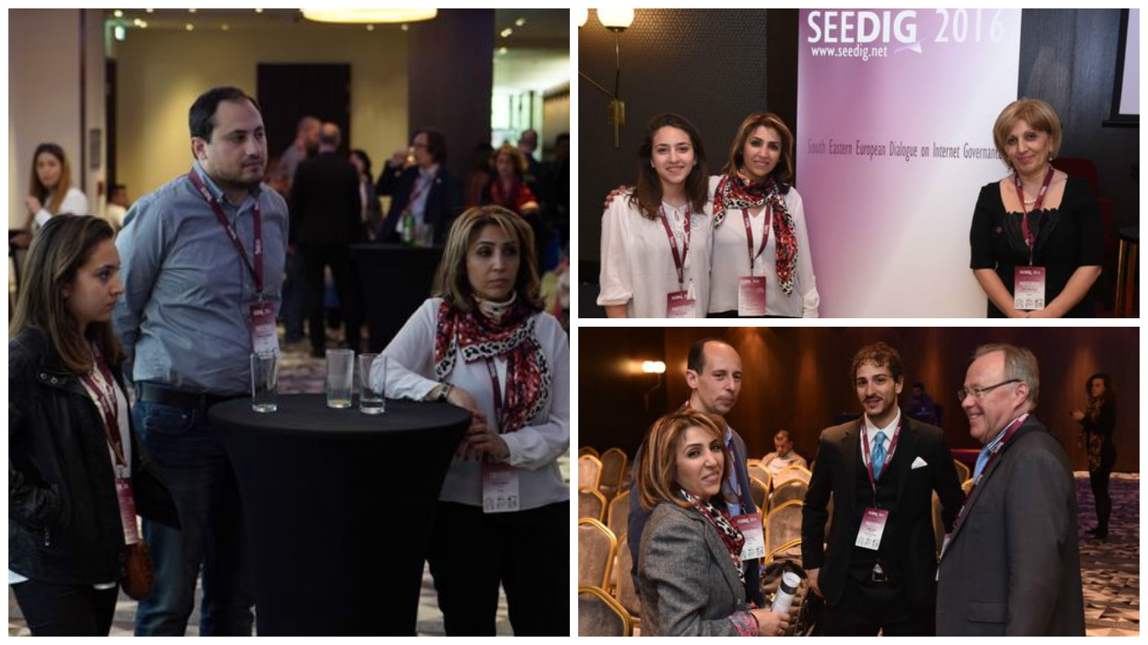
SEEDIG 2016

Slide 23
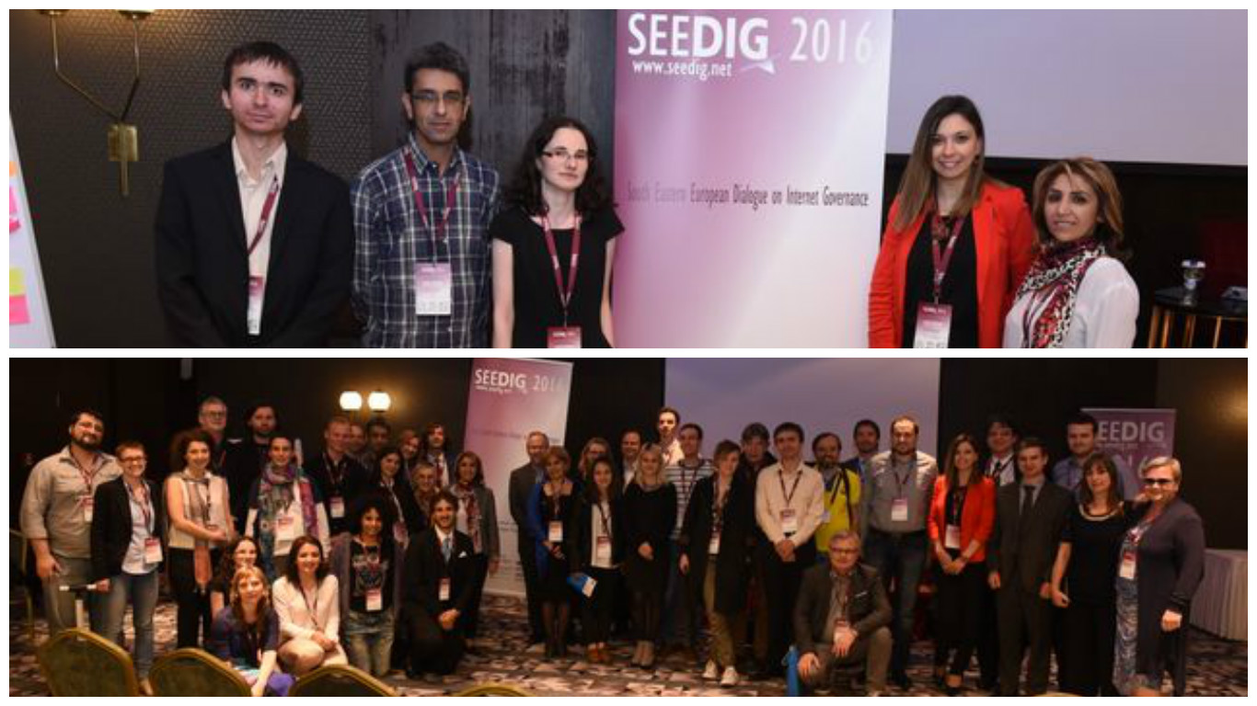
SEEDIG 2016

Slide 24
Thank you!
Lianna Galstyan
ISOC Armenia Board Member
SEEDIG Executive Committee Member
lianna@isoc.am
SEEDIG 2015, 22 April, 2016, Belgrade, Serbia

